Slide 1
The Hopeful Path to Engaging the Front Line and Sustaining Improvement
Douglas S. Brown, JD
President, Community Hospitals and CAO,UMMHC

Slide 2
Themes
Humility
Love
Meaning

Slide 3
We must take care of these three things to engage our staff in order to reduce errors, improve quality and transform our system
In part, this is an individual commitment and in part it is an organizational one
Through this talk, I will share a bit about how UMass Memorial tries to take care of these things and how Doug Brown tries to do so

Slide 4
Humility
Taking Care of Our Ego
A Personal Reflection

Slide 5
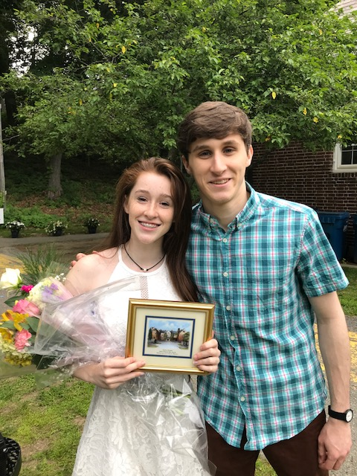

Slide 6
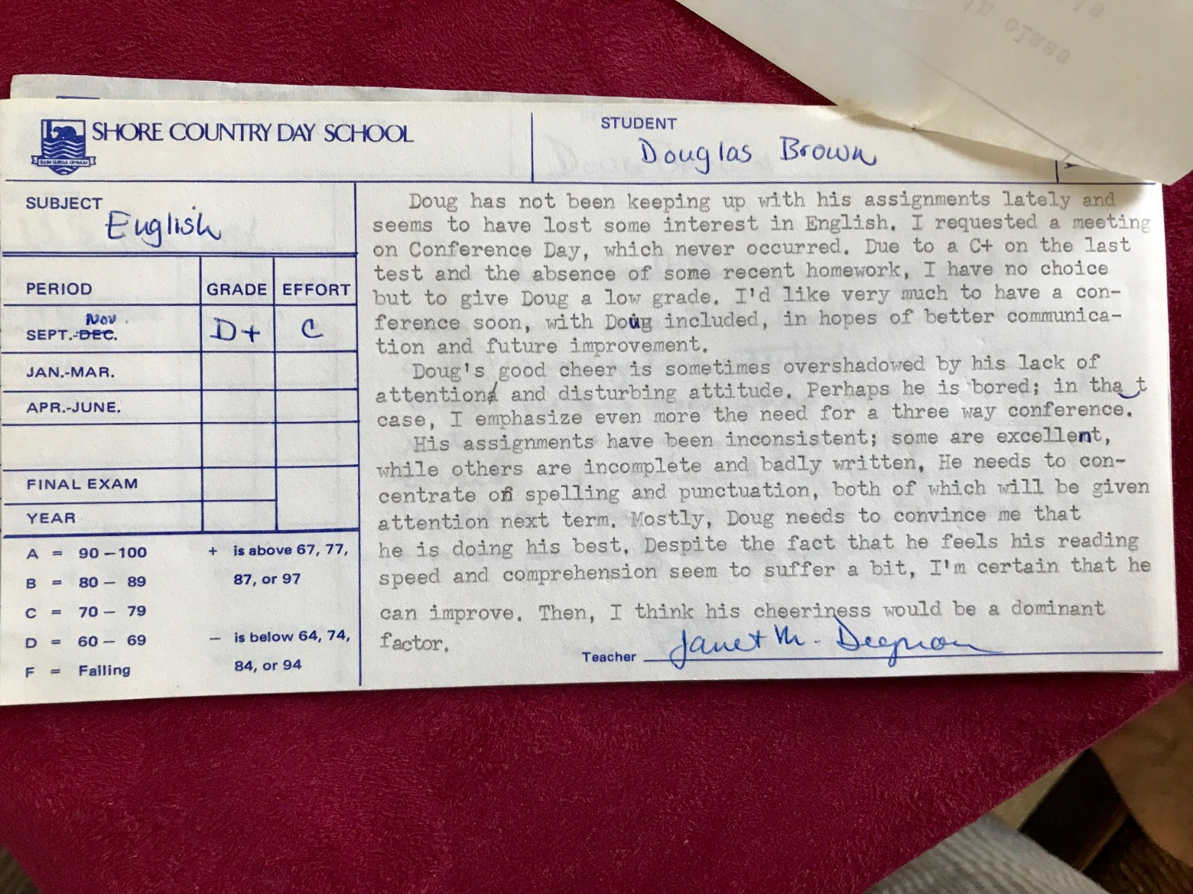

Slide 7
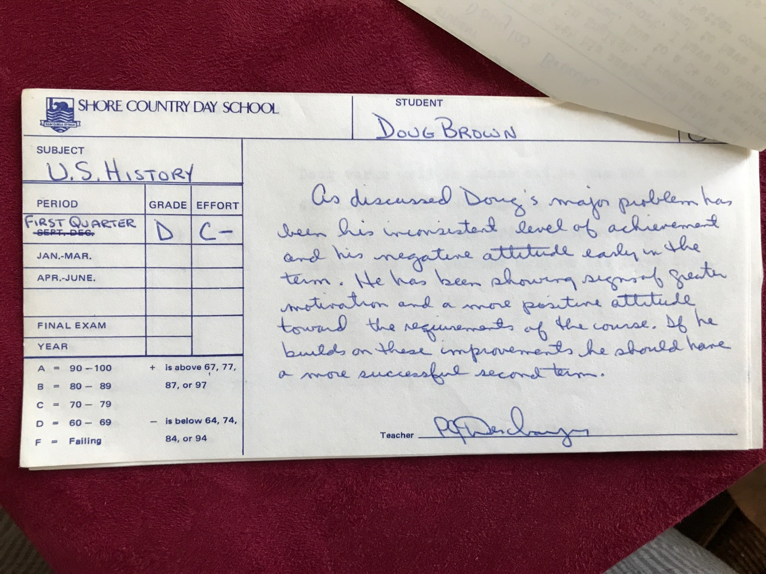

Slide 8
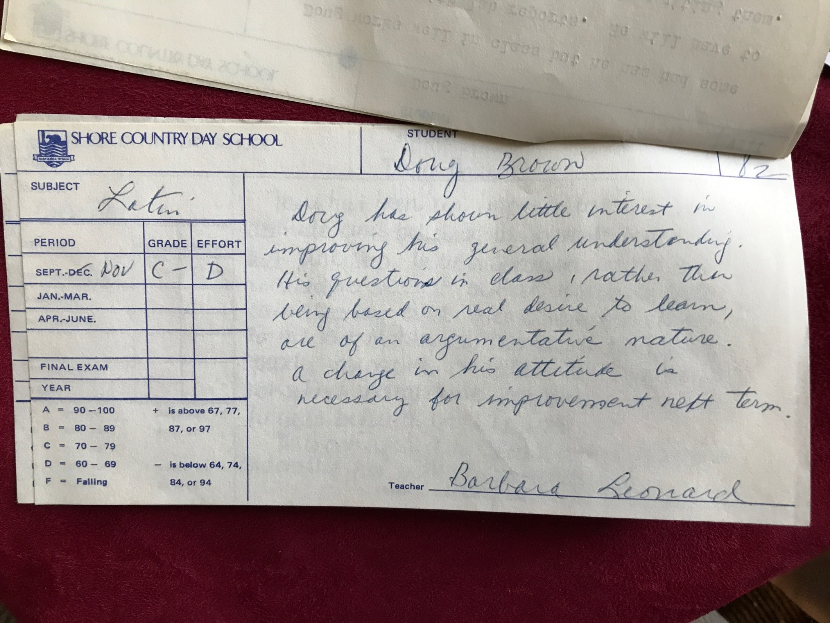

Slide 9

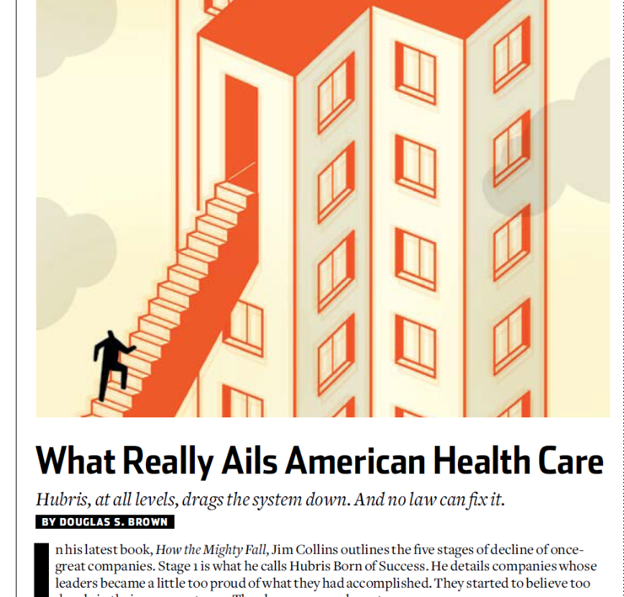

Slide 10
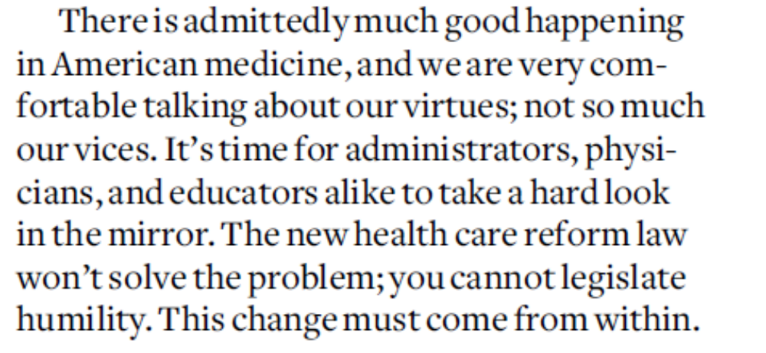

Slide 11
“Imitate Jesus and Socrates.”

Slide 12
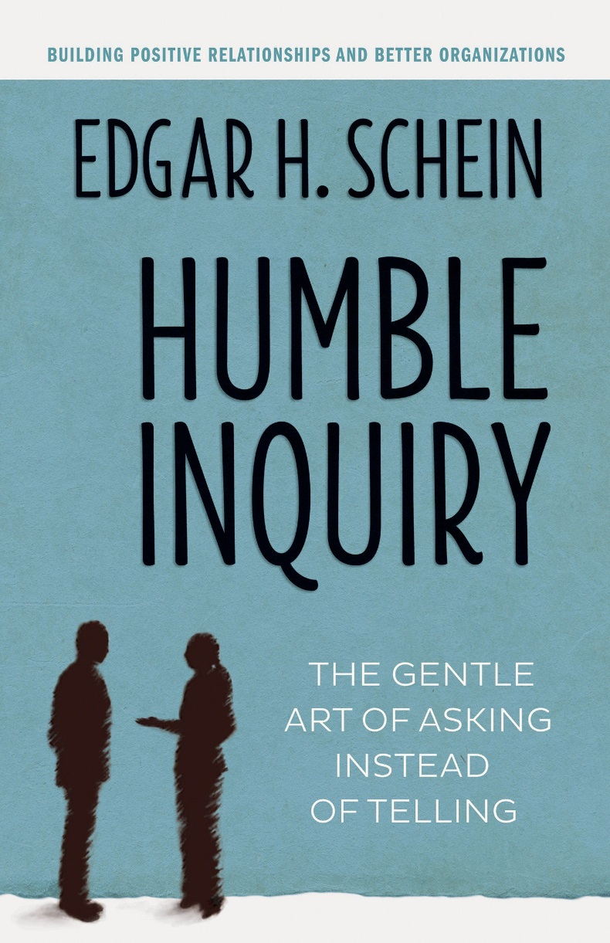

Slide 13
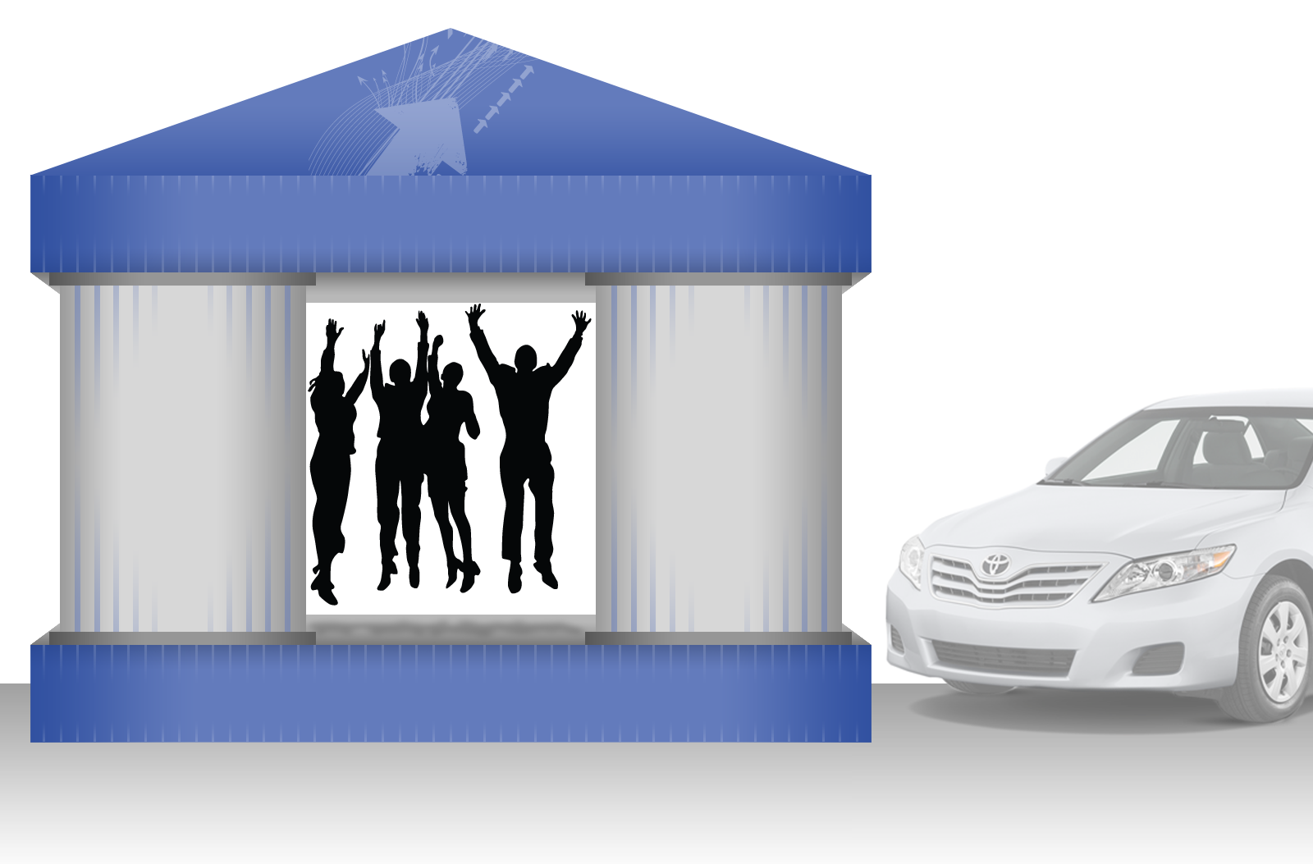
The Toyota Way
True North
Best Quality – Low Cost – Shortest Lead Time
Best Safety – Highest Morale
Continuous
Improvement
Respect for
People
PDCA Learning Cycles

Slide 14
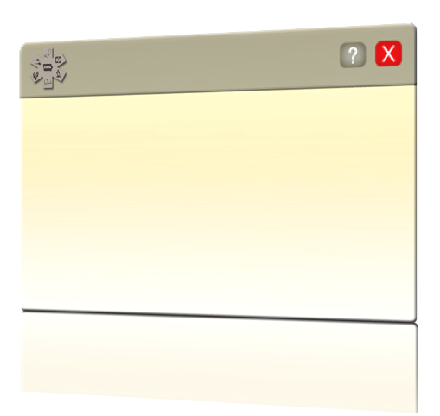
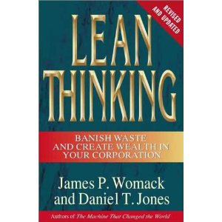
Lean Is…
“The endless transformation of waste into value from the customer’s perspective”.
Lean Philosophy
Womack and Jones, Lean Thinking
Lean increases product value by removing waste and slowly driving a process towards perfection.
Notes:
13
So what is this lean philosophy all about The goal of Lean is to constantly increase product value by removing waste and driving a process towards perfection or as Womack and Jones eloquently state in their book Lean Thinking, Lean is the endless transformation of waste into value from the customer’s perspective........
The Lean philosophy was born within Toyota and now thrives in many companies and industries around the world......It is not a panacea that without much effort produces great results...rather.... it is a philosophy that, when coupled with hard work and perseverance, increases the likelihood that you will achieve operational excellence.

Slide 15
“It is impossible to improve any process until it is standardized. If the process is shifting from here to there than any improvement will just be one more variation that is occasionally used and mostly ignored. One must standardize the process before improvements can be made.”
Masaaki Imai

Slide 16

Best Place To Give Care – Best Place to Get Care

Slide 17
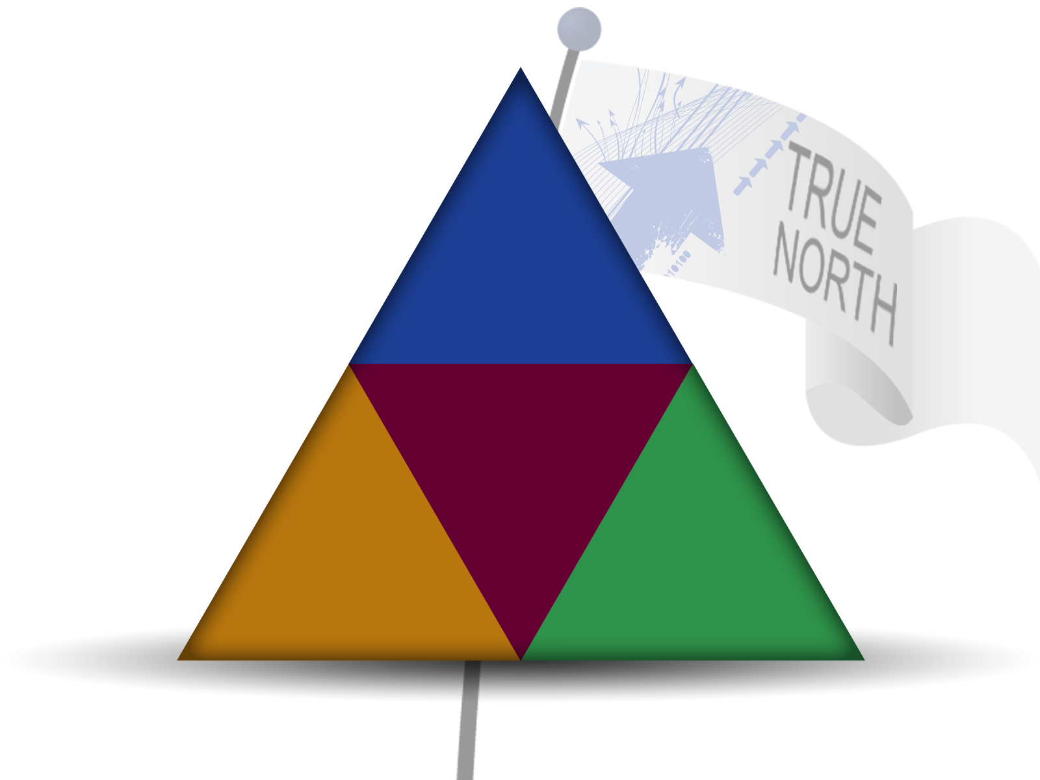
Best Place To Give Care – Best Place to Get Care
Our
Patients
Inpatient Mortality
ED Borders
AQC Gate Scores
HCAHPS
Access Score
Our
People
Caregiver Engagement
Our
Long-Term
Financial Health
Days Cash on Hand
Operating Margin
Our
Discoveries
Number of Ideas Implemented
Clinical Research Funding
Notes:
16
ERIC

Slide 18
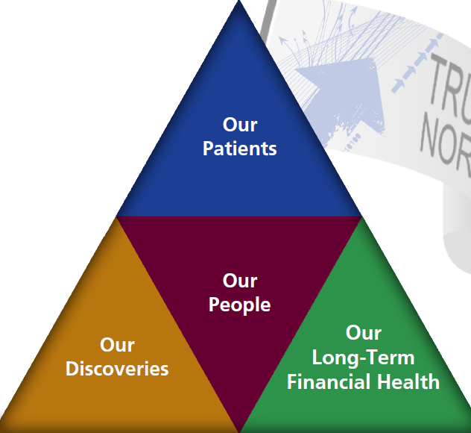
Aligning the Organization With True North Using
3 Levels of Visual Management
Level 1 – UMMHC (system)
Level 2 - Individual Entities and Major Business Units (IT Marketing etc..)
Level 3 – Individual patient care areas and business units

Slide 19
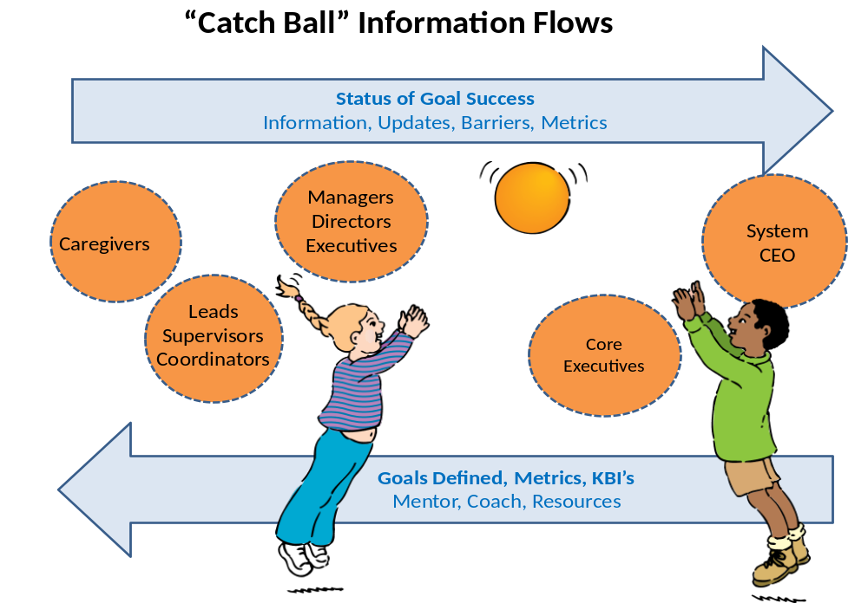
System
Entity
Department

Slide 20
Standard Work:
UMass Memorial Health Care Management System
Version 11
Strategic Planning
Strategic Execution, Alignment and Performance Measurement
Operating budget
Business development and capital investment
System Support Services
System Service Lines
Development Activities

Slide 21
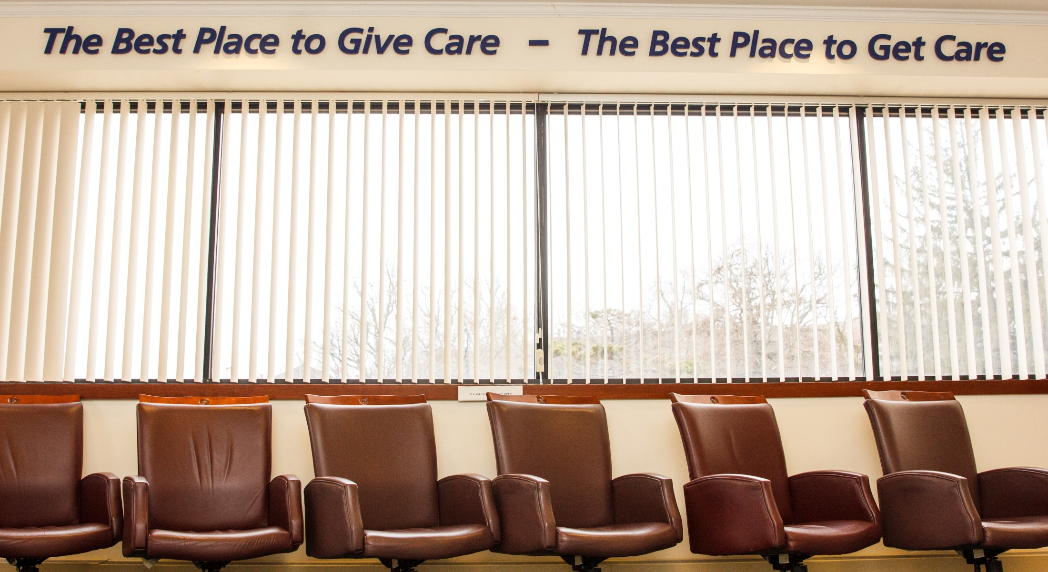
Level 1 Visual Management System

Slide 22
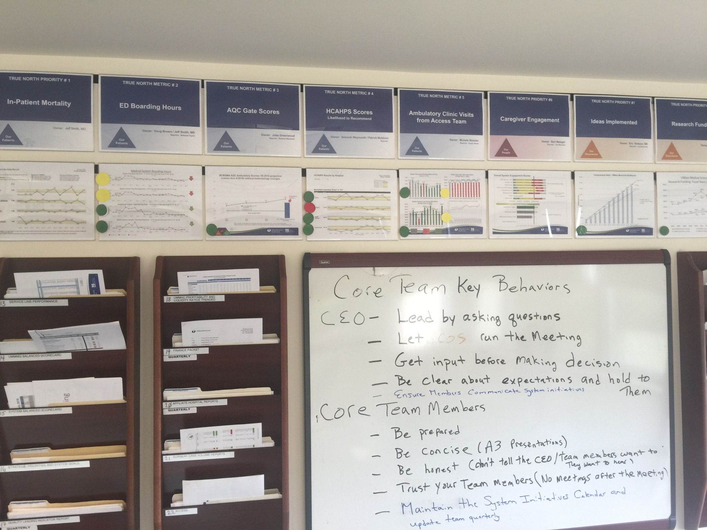

Slide 23
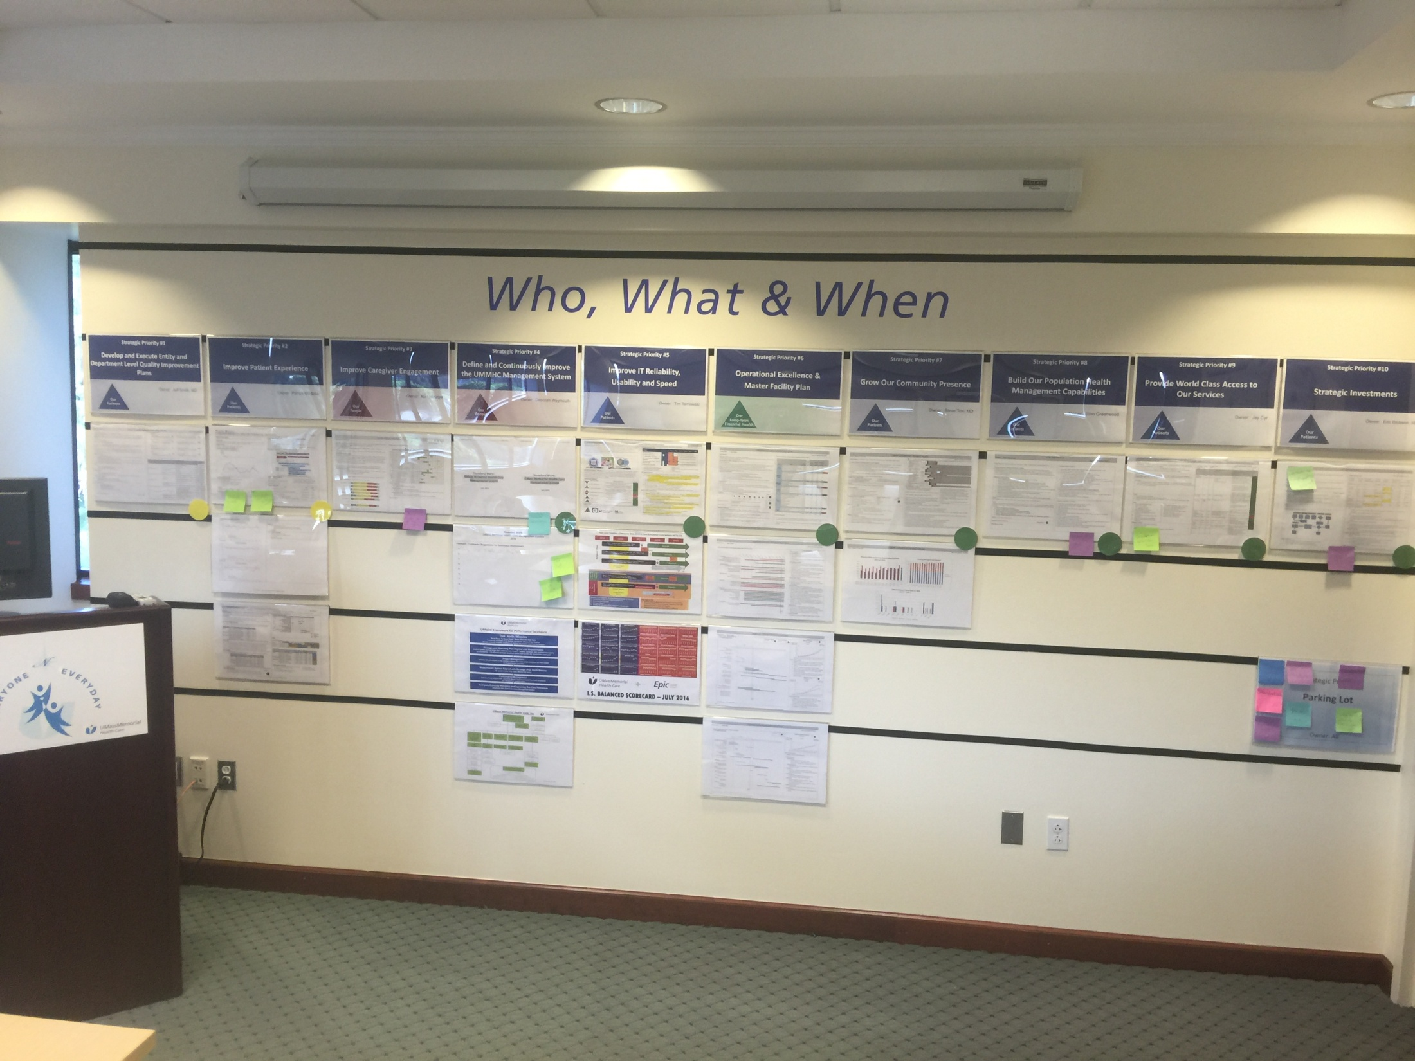

Slide 24
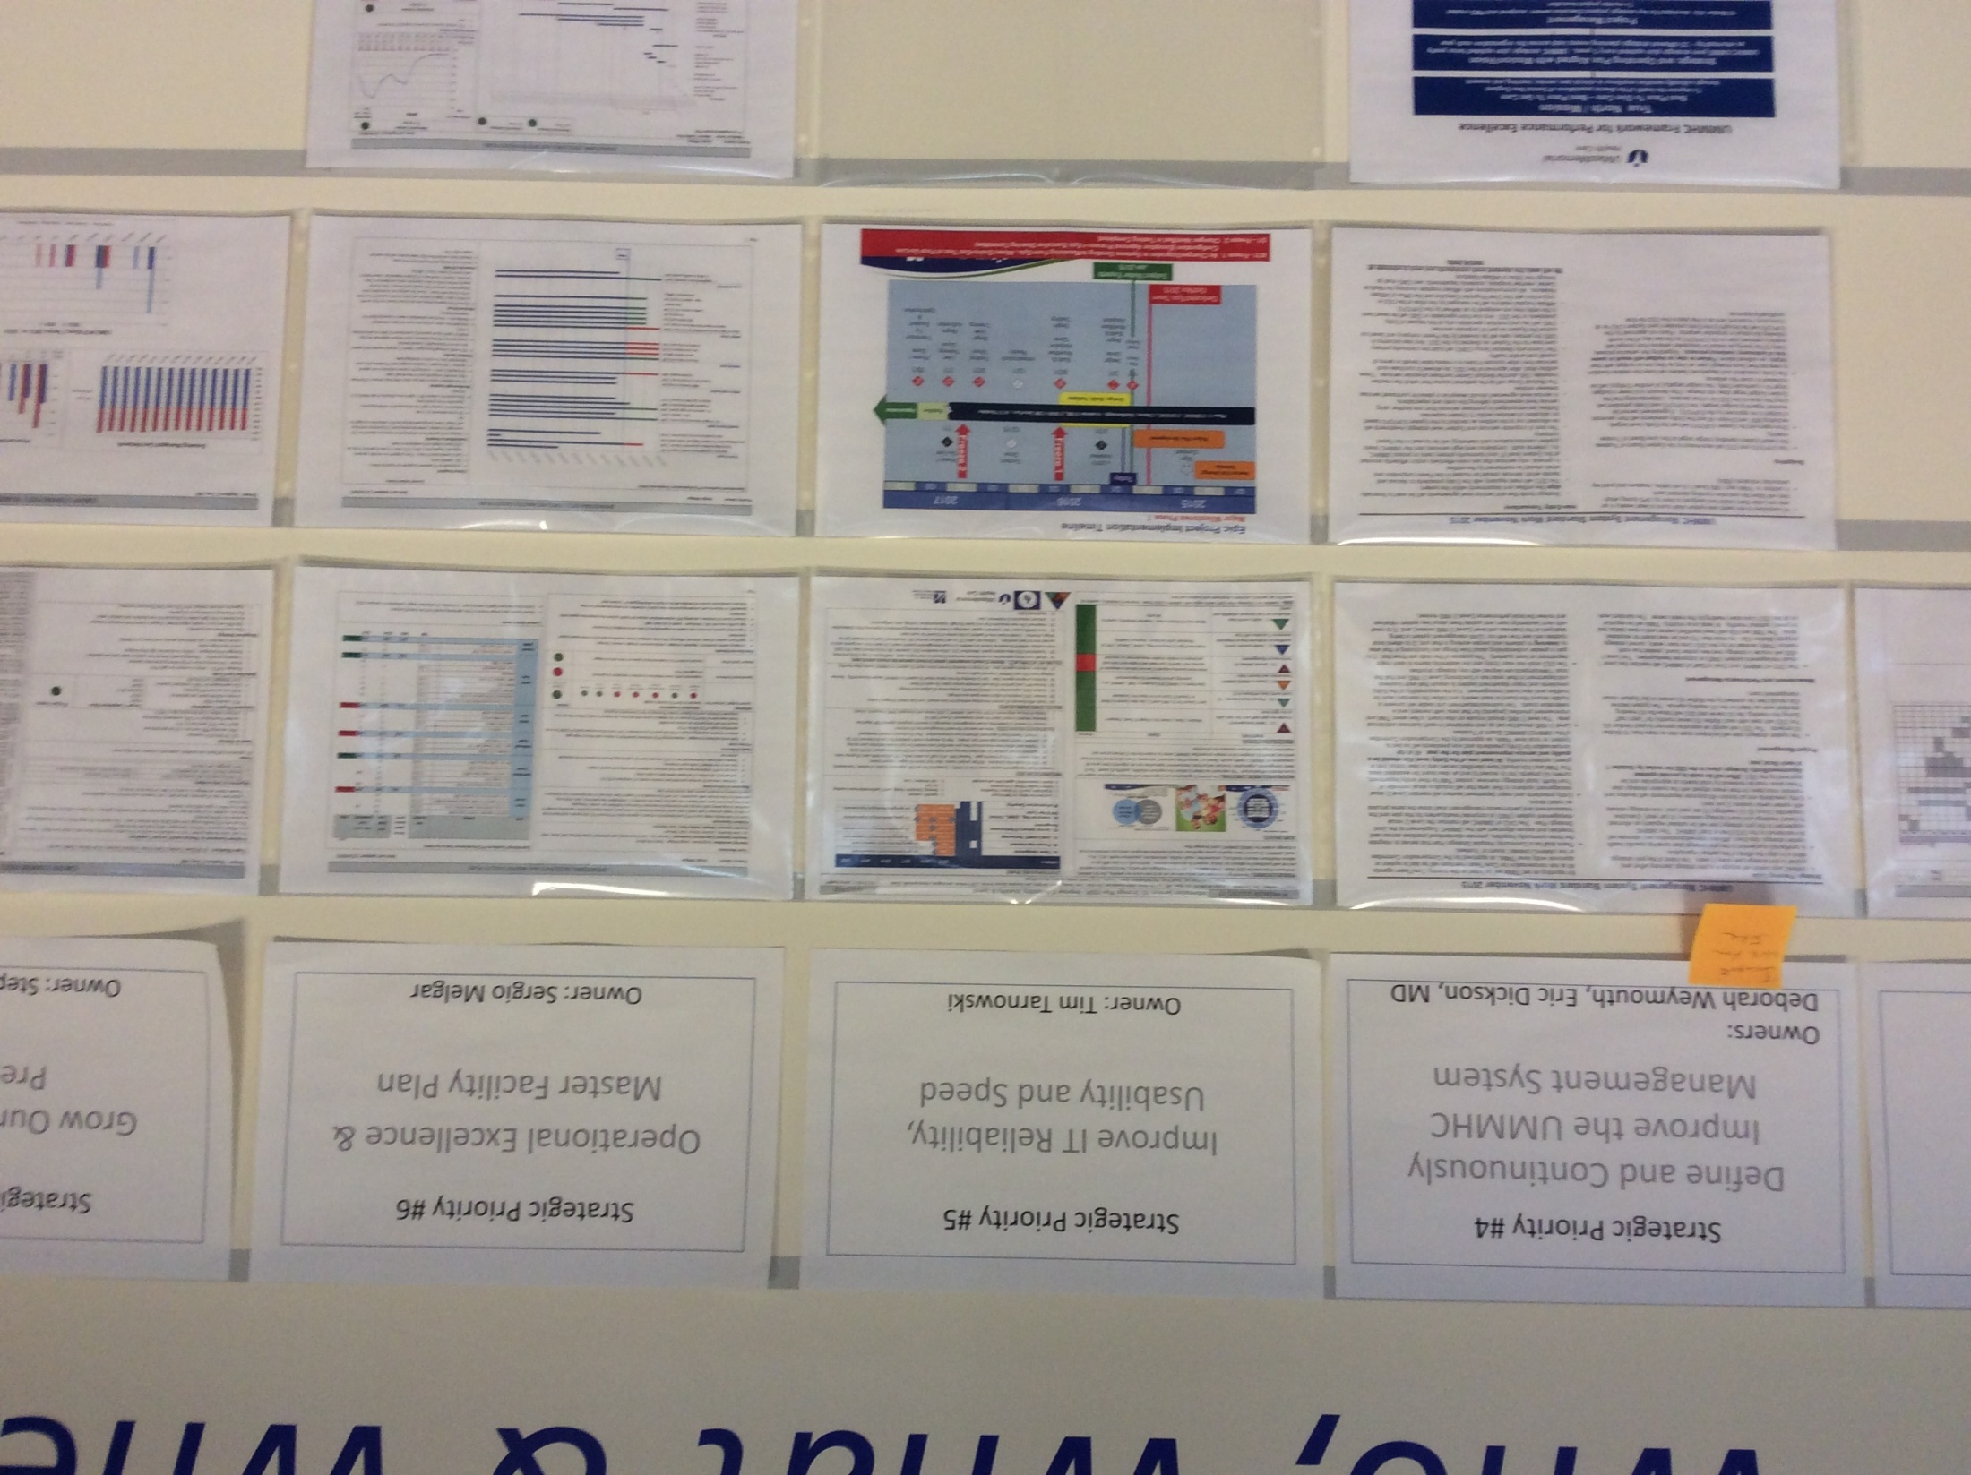

Slide 25
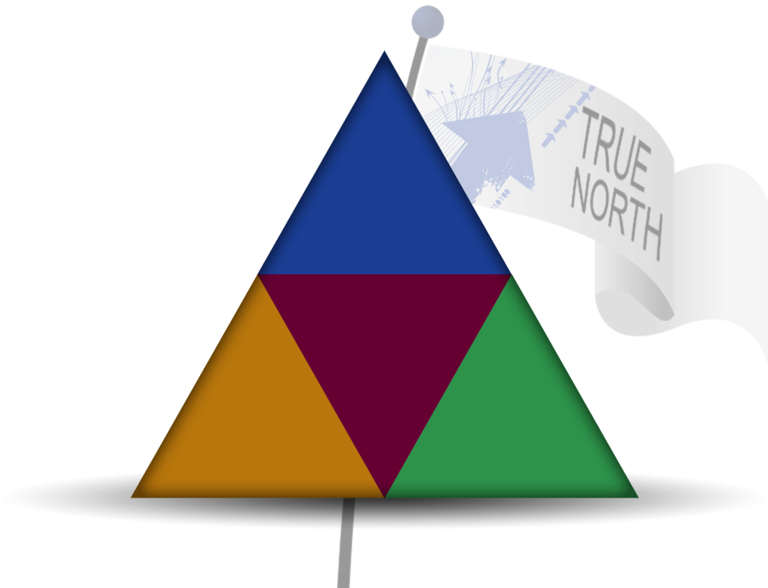
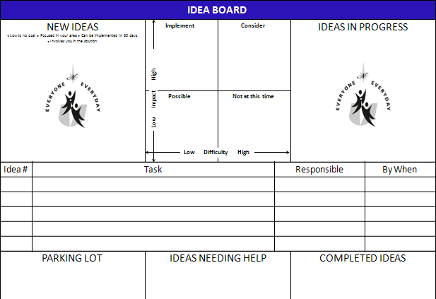
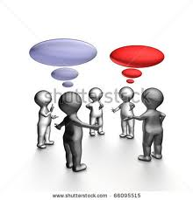


Unit Based Idea System (Level 3 VMS)
Patients
People
Financial
Sustainability
Innovation
A place on every unit where the team comes together at an idea board, talks about performance (TNM), ideas for improving performance, tracks progress on ideas being implemented (PDSA) and celebrates success.
Notes:
ERIC

Slide 26
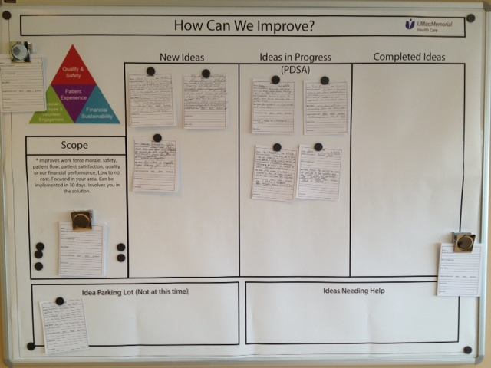

Slide 27
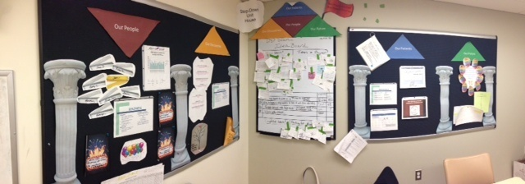
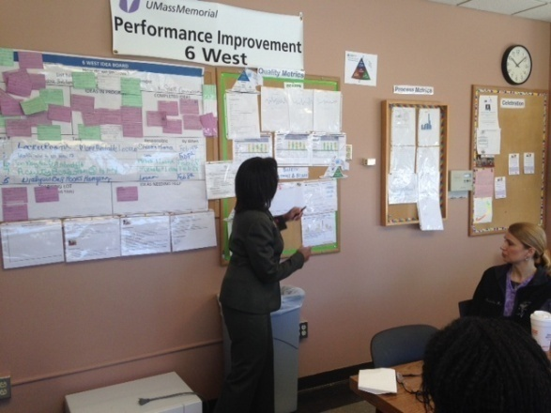
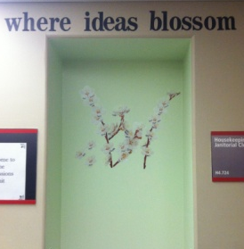
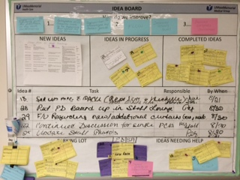
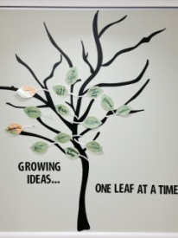
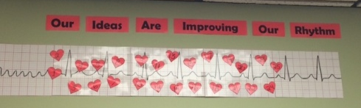
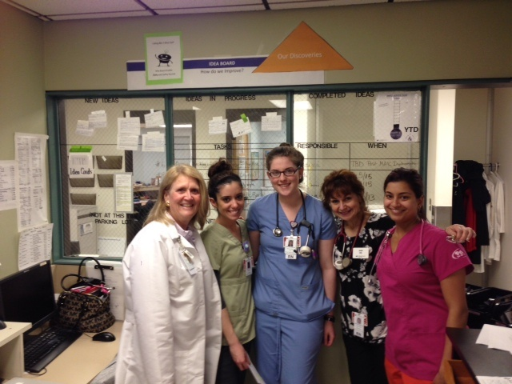
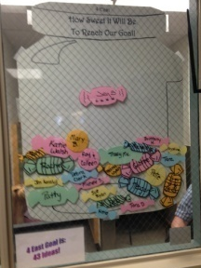
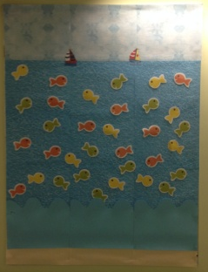
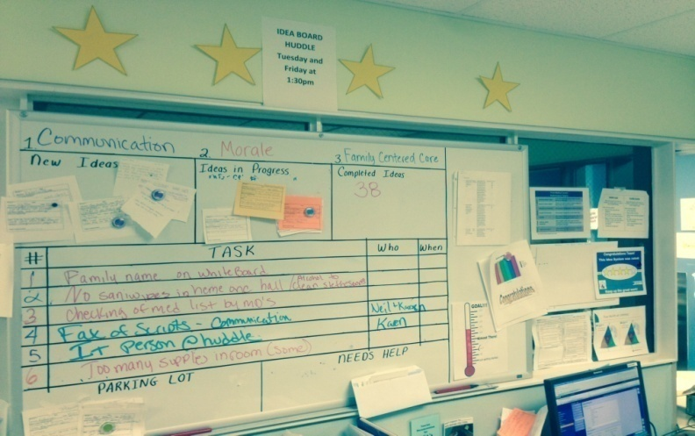
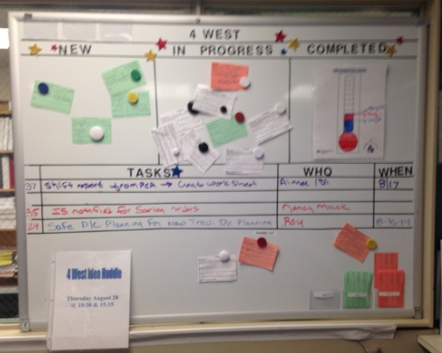
Inpatient Nursing Units
3 Lakeside Step Down
6 West
4 Admissions Unit
3 East & West
4 East & West
5 East

Slide 28
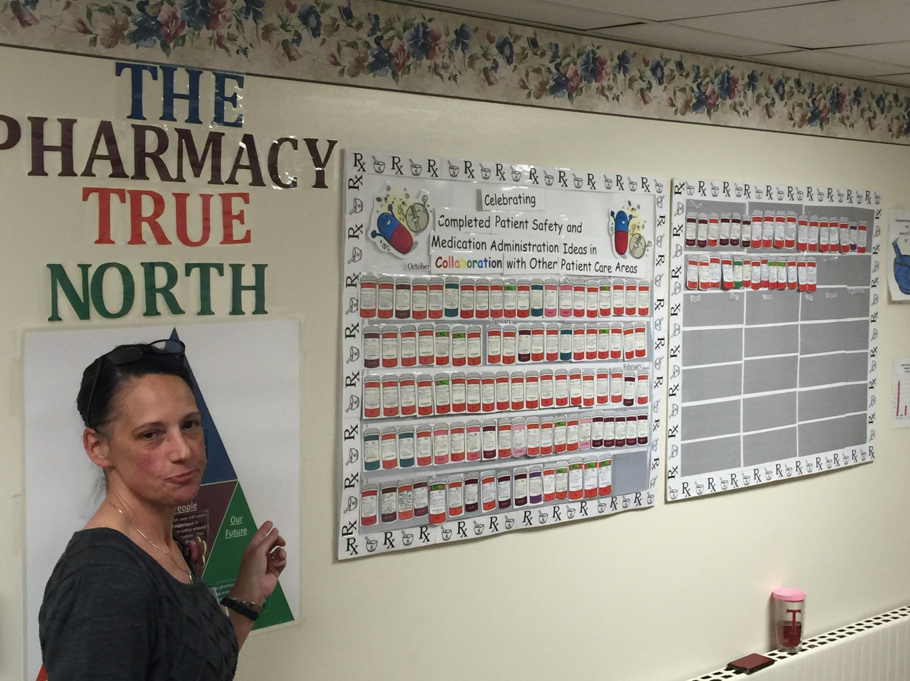

Slide 29
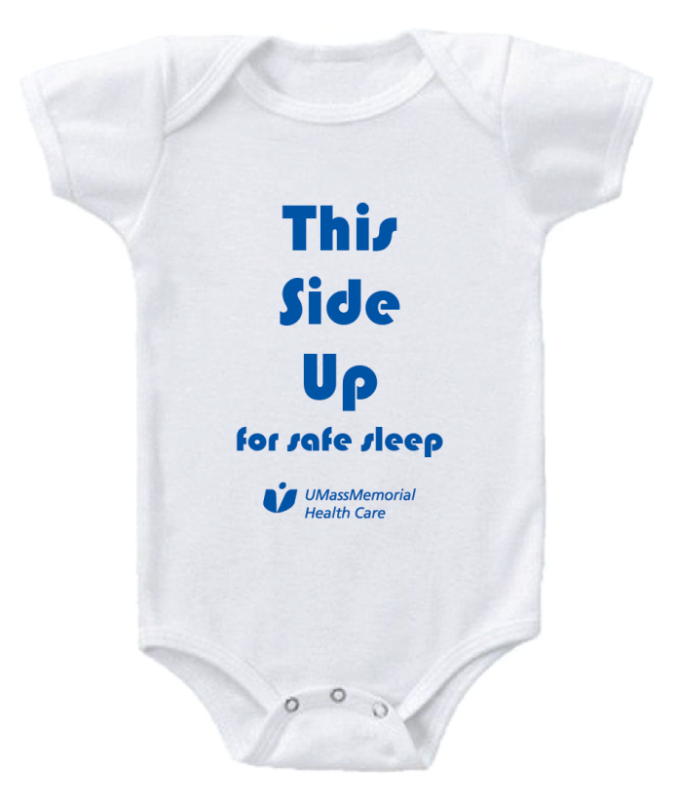
Maternity team idea
Funded from Innovation fund
Maternity team at Memorial requested materials to educate families on safe sleep practices, which is a focus of DPH this year. The team identified a book for families and designed a visual reminder of the safe sleep position. Congratulations to the Maternity team!

Slide 30
Love
Taking Care of Each Other
Standards of Respect

Slide 31
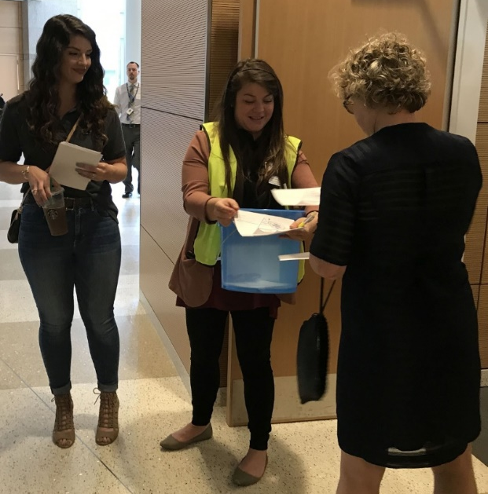
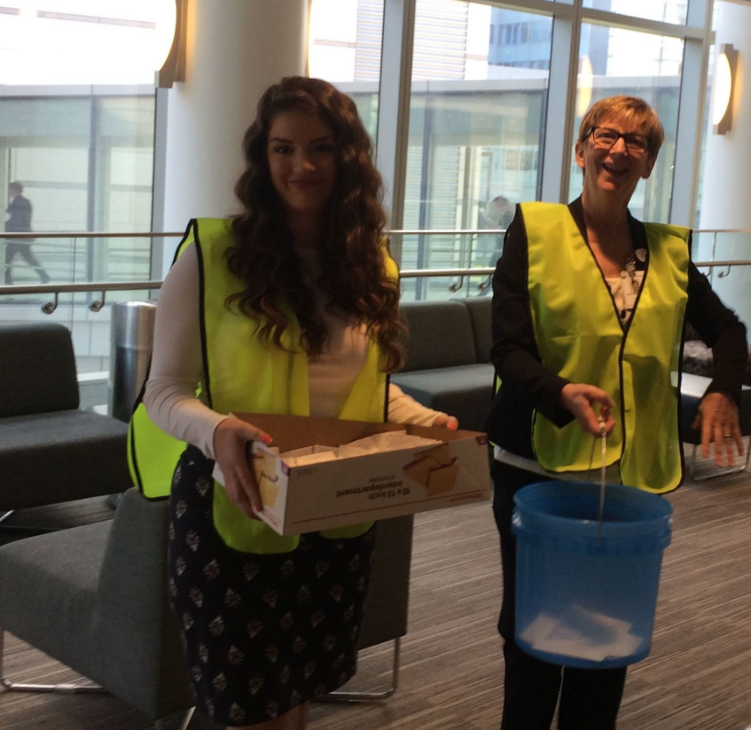
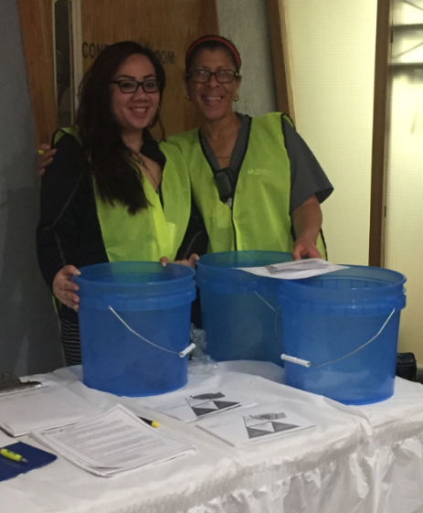
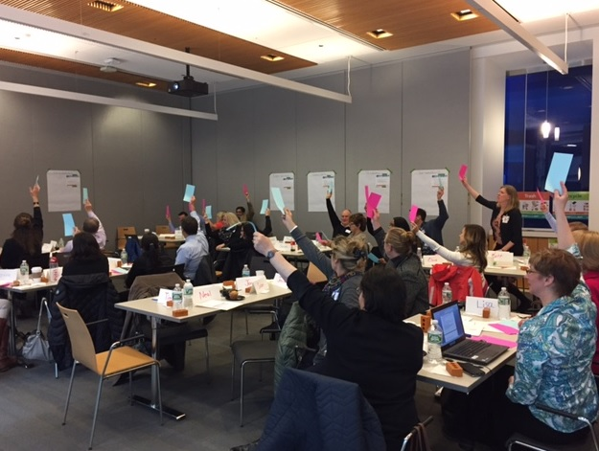
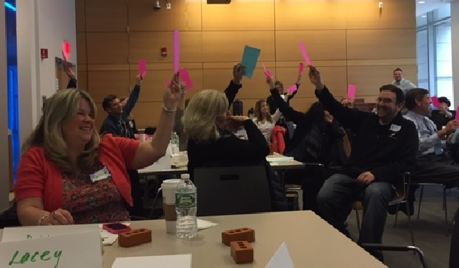
I feel supported and respected when ___________.
Notes:
Slide 3: Retreats/pictures
SCRIPT
In 2017, during numerous retreats and focus groups, they began to transform into an internal movement. The turning point came through a survey, when caregivers at UMass Memorial were asked to finish a simple sentence. And 2,306 team members across areas and departments answered the call. The sentence was…
Build: “I feel supported and respected when ___________.”

Slide 32
I feel supported and respected when ___________.
MY EMAILS ARE RETURNED QUICKLY
OUR VOICES ARE HEARD
MY CO-WORKERS HELP OUT NO MATTER WHAT THEIR TITLE
Notes:
Slide 4:
SCRIPT
The answers ranged from things like:
Build: OUR VOICES ARE HEARD
Build: MY CO-WORKERS HELP OUT NO MATTER WHAT THEIR TITLE
and
Build: MY EMAILS ARE RETURNED QUICKLY

Slide 33
I feel supported and respected when ___________.
NEVER
I CANNOT RELATE TO THIS STATEMENT
RARELY
I DON’T FEEL RESPECTED
Notes:
Slide 7: And some answers were concerning:
“I feel supported and respected…”
Build: -RARELY
Build: -NEVER
Build: -I CANNOT RELATE TO THIS STATEMENT
Build: -I DON’T FEEL RESPECTED
(TIP: After you finish reading the response “I don’t feel respected”, you can provide your own observation on that. It could be something like “clearly this showed we had a problem” or “I think we all have been in a department where we felt that way or we know a co-worker who did.”)

Slide 34
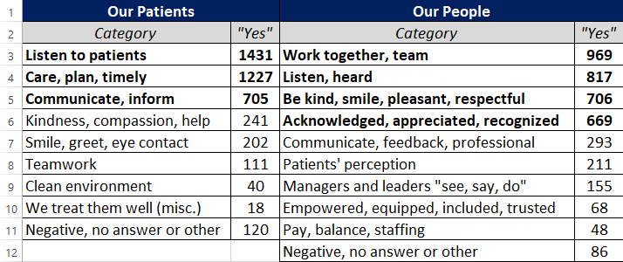
Our patients feel supported and respected when __________.
Notes:
Slide 9: Our patients…
SCRIPT
“Our patients feel supported and respected when ________________.”
Build: (spread sheets with answers)
SCRIPT
In total, a core team gathered and analyzed nearly 5,000 responses. And that’s how we discovered we could meet Aretha Franklin’s challenge to find out what respect means to us. We looked for patterns. It quickly became clear that we could group almost all 5,000 responses into six, straight forward Standards of Respect. And they are … coming.

Slide 35
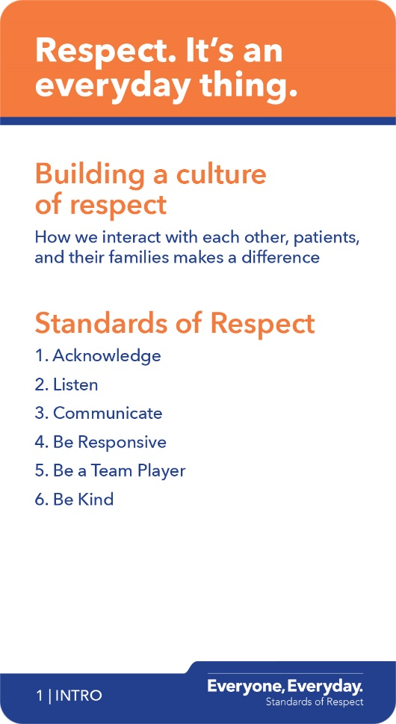

Our six Standards of Respect
Notes:
Facilitator 2:
Slide 23: Standards of Respect
SCRIPT
Okay, time to reveal our six Standards of Respect. And they are…in the cards. Open up the deck of Respect cards in front of you. Push from the bottom. Pull out the first card.
Build: Turn it over, and there you have our six standards. And they are…
1. Acknowledge
2. Listen
3. Communicate
4. Be Responsive
5. Be a Team Player
6. Be Kind
(point out SOR one-page flyer)
You can also see all the six Standards of Respect on the full-page flyer on your table.
Now, we could do a two-hour training class on each of these six topics. But we’re not. For example, we’re not trying to teach you how to be a better listener today… but how to listen to show respect.
We’ll emphasize slightly different kinds of definitions for words you may normally think of in a broader way. It’s all about respect. So, let’s get to those definitions. And for that, we use the cards. Plus, you can use them to help drive conversations with others and your teams.

Slide 36
Our Standards of Respect
1
4
ACKNOWLEDGE
BE RESPONSIVE
2
5
LISTEN
BE A TEAM PLAYER
3
6
COMMUNICATE
BE KIND
Notes:
Facilitator 1:
Slide 45: Summary of SORs
SCRIPT
Well, there you have it…the six Standards of Respect:
Acknowledge, Listen, Communicate, Be Responsive, Be a Team Player, Be Kind.

Slide 37
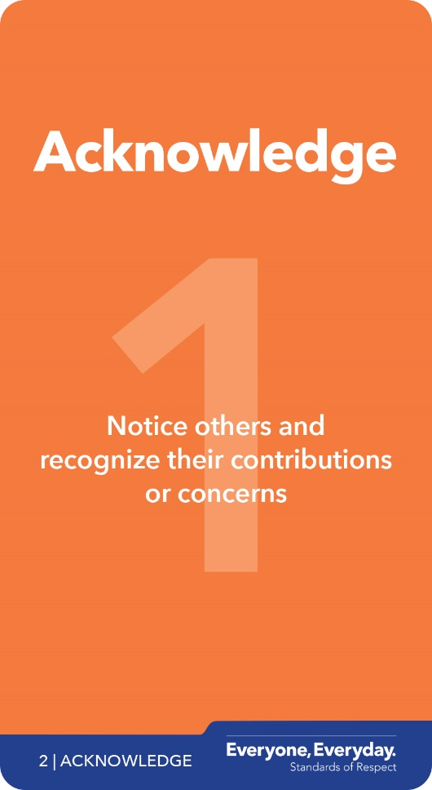
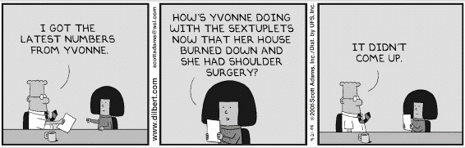
ACKNOWLEDGE
Notes:
Slide 26: Acknowledge
SCRIPT
Have you ever noticed how true to life Dilbert cartoons are? Take a look… (slide show cartoon). Build. Build. Build.
Here’s the truth that this Dilbert cartoon revealed. When you only acknowledge systems or work … and ignore the fact that you are interacting with real people … it has a cost.
Every time we take someone else for granted or see them as a ‘means to an end’, we are failing to recognize their contributions. Acknowledging our patients' concerns is the other element of this standard. … noticing them, really paying attention to them … and recognizing their concerns. So, let’s explore this.

Slide 38
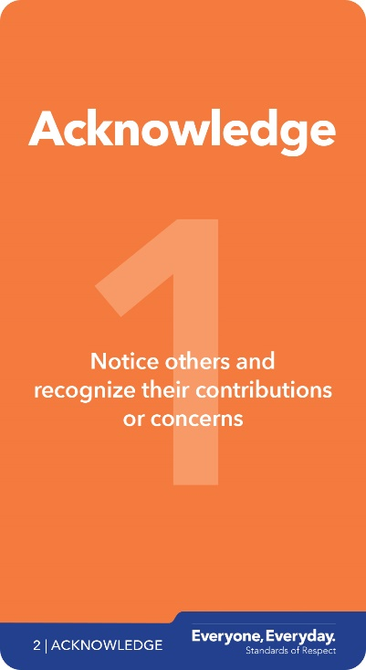
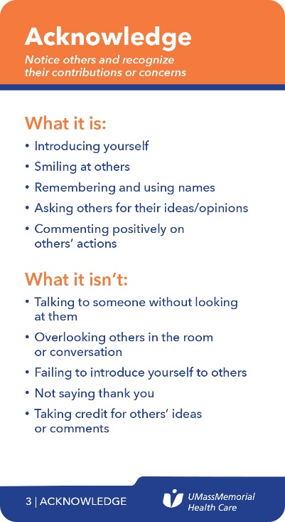
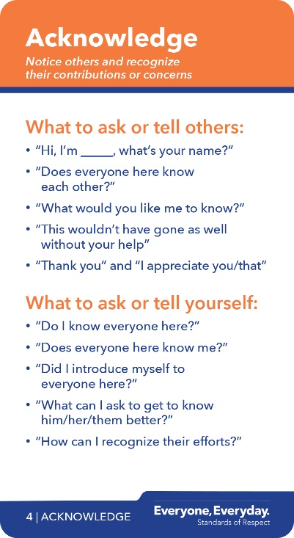
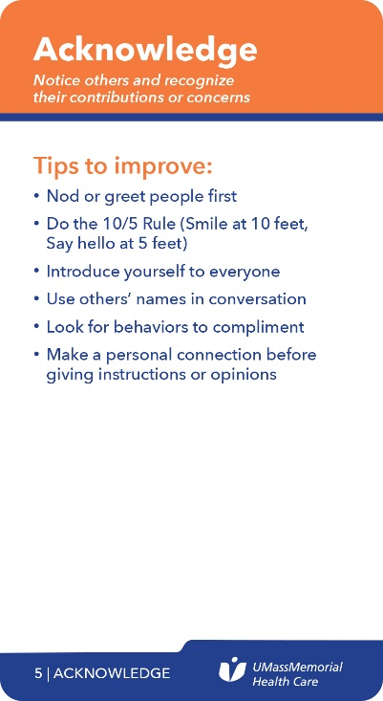


KNOWING THE CARDS
What you currently do.
What you currently don’t do.
Notes:
Slide 28: Table Time
SCRIPT
Let’s explore these cards. Pair up with another colleague at your table. If you have an odd number at your table, form a group of three with someone odd!
Read all the bulleted items on just the first card…in the What it is and What it isn’t categories. Then … candidly tell your partner what you currently do, and what you currently DON’T do. Take about a minute to do that.
(Attendees do Table Time exercise)
Build: After reviewing just ONE card we already see where we all contribute to respect AND disrespect. The opportunity is…there are three more categories.
Build: There’s a great tip we can all try out. It’s the second bullet in the Tips to Improve category – called The 10 / 5 Rule.
It means when walking down a hallway or entering a conference room you smile at someone at 10 feet, and then say hello at about 5 feet. We’re talking about that moment when you see someone and you’re like “Did they see me? What do I do here? Do I say something? … No? … Is it awkward if I say something and they don’t say anything back?”
Now, a fair question is…will simply smiling at 10 feet and saying hello at 5 feet actually make a difference in how people feel acknowledged?

Slide 39
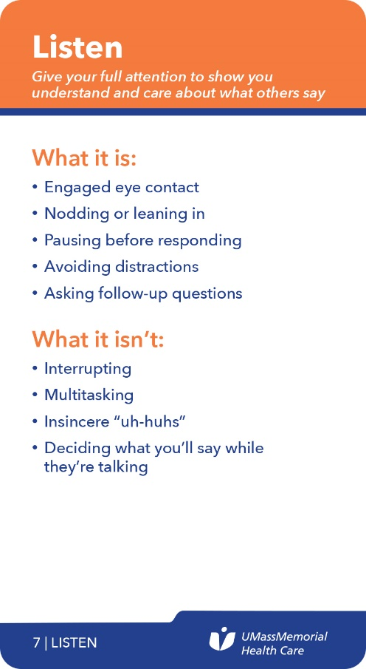
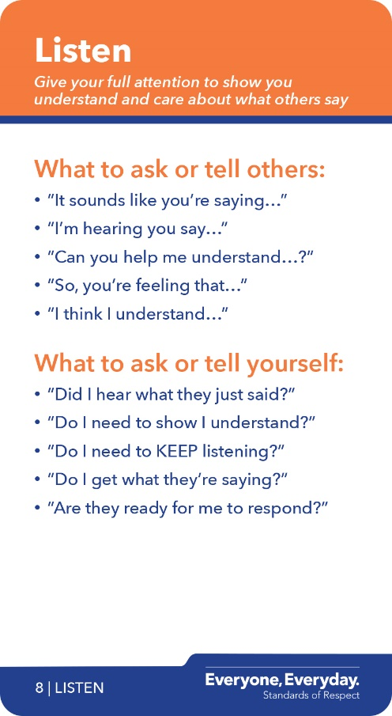
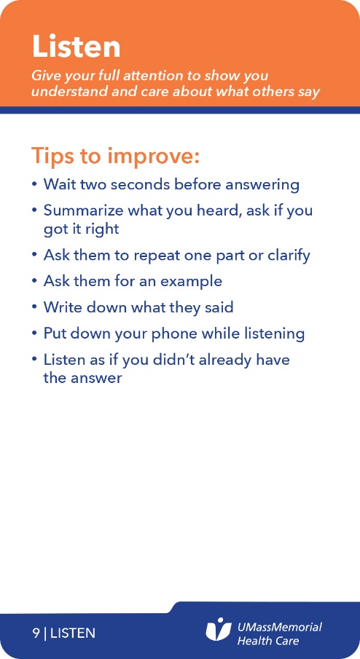

Notes:
Slide 32: Too quick
Take a look at the first bullet on the Tips to Improve Listen card. Call it the Two Second Rule. We’ll demonstrate with a little role play.
So, ______, what’s your favorite show to binge-watch on Netflix.
Facilitator 2
I’d have to say Parks & Recreations...
Facilitator 1
(cutting off end right at the end of “Recreations”).
Good choice, but I think Stranger Things is the one to watch.
Notice how quickly I started talking. Does _____ feel respect or disrespect based on how I’m listening? (get responses from attendees)
Now, we’ll do the same thing, with the only difference being, I simply wait two seconds.
So, ______, what’s your favorite show to binge-watch on Netflix.
Facilitator 2
I’d have to say Parks & Recreations.
Facilitator 1
(waiting two seconds while nodding)
Good choice. But I think Stranger Things is the one to watch.
Did you see how two seconds showed I was listening BEFORE I replied? That’s a great respectful listening tip.

Slide 40

BE RESPONSIVE
Notes:
Facilitator 2:
Slide 35: Back to your card deck…and BE RESPONSIVE.
SCRIPT
We need a volunteer definition reader.
Volunteer: Respond in the expected timeframe to show others’ priorities are important to you, too.
Thank you. Now, ‘Be Responsive’ isn’t always about being fast. It’s about meeting expectations of responsiveness … what THEY expect … and, if we can’t deliver what is being asked of us in the proposed timeframe, letting them know when we can. If we don’t, we are perceived as showing disrespect.
We’ve all been on the receiving end of this … so, to remind ourselves how maddening a slower-than-expected response feels like we’re going to use a little humor and visit a sloth working at the DMV from the movie Zootopia.

Slide 41

Notes:
Slide 36: Zootopia movie clip
SCRIPT
Whoooh, that is an “I feel your pain” moment. (ad lib more commentary)

Slide 42
How to Make it Sustainable
Training: We are developing online tools and job aids that managers and teams can later access to sustain and reinforce a focus on the Standards at team meetings and huddles.
Integration: We are looking at all of our processes and determining how we integrate the Standards of Respect into them. (Performance management; job descriptions; hiring processes; new caregiver and physician orientations; visual management systems; and huddles)
Evaluation: peer feedback; senior leader and manager evaluations.
Governance: Multi-year plan; system-wide steering committee. All 13,000 employees will be going through this training.

Slide 43
Meaning
Taking Care of Our Community

Slide 44
How to Find Joy and Meaning in Work?
Help employees see larger cause
Engage them around core mission (which is changing)

Slide 45
Our Challenge
“As the nation shifts toward prioritizing community health improvement, healthcare leaders are confronting new questions about their role in addressing non-clinical factors that impact health outcomes, such as how to improve access to basic needs like affordable housing and healthy food.”
-The Democracy Collaborative
Place-based Investing Toolkit

Slide 46


Slide 47


Slide 48


Slide 49


11.3 Year Difference in Life Expectancy between Exit 21 and 22
90 year life expectancy
Exit 21
Life Expectancy 73.9 Years
Exit 22
Life Expectancy 85.2 Years
70 year life expectancy
Prepared by the Office of Clinical Integration
Data Source: USALEEP 2018
Notes:
Less than 1 mile. ~0.8 Miles separate these exits

Slide 50
Definitions
Anchor Institution
Nonprofit or public institutions firmly rooted in their locales (Eds and Meds), Often have social or charitable purpose, are placed-based and tend to stay put, Vested self interest in helping to ensure communities are safe, vibrant, healthy and stable
Anchor Mission
Commitment to consciously apply the long term, place-based economic power of the institution, in combination with its human and intellectual resources, to better the long term welfare of the community in which the institution is anchored.
3 Pillars
Sourcing, Hiring, Investing

Slide 51


Retreat Quotes
“I am proud of our organization.”
“Words cannot explain my appreciation for being included in this work.”
“This is the coolest thing I have ever done at UMass Memorial.”
Notes:
“I am proud of our organization.” “Words cannot explain my appreciation for being included in this work.” “This is the coolest thing I have ever done at UMass Memorial.”

Slide 52


“I am privileged to work with such awesome and passionate people.”
“I will always remember this day.”
“This gets me outside the daily grind to think about something bigger.”
Notes:
“I will always remember this day.”
“This gets me out of the daily grind to think about something bigger.”
“I am privileged to work with such awesome and passionate people.”

Slide 53
Humility
Love
Meaning

Slide 54
Contact Information
Douglas S. Brown
President, Community Hospitals and
Chief Administrative Officer
UMass Memorial Health Care
365 Plantation Street, Suite 300
Worcester, Massachusetts 01605-2376
Tel: 508-334-0424
douglas.brown@umassmemorial.org

